Slide 1
Python – Data Type Conversion
Practice

Slide 2
Python Data Types
The type of a variable is specified using Python Data Types.
It outlines the kind of information we'll put in a variable.
Many forms of data can be kept in memory.
A person's address and age, for instance, are both kept as alphanumeric characters and numeric values, respectively.

Slide 3
Python Built-In Data Types
Numeric
String
Sequence
Mapping
Boolean
Set
int, float, complex
str
list, tuple, range
dict
bool
set, frozenset

Slide 4
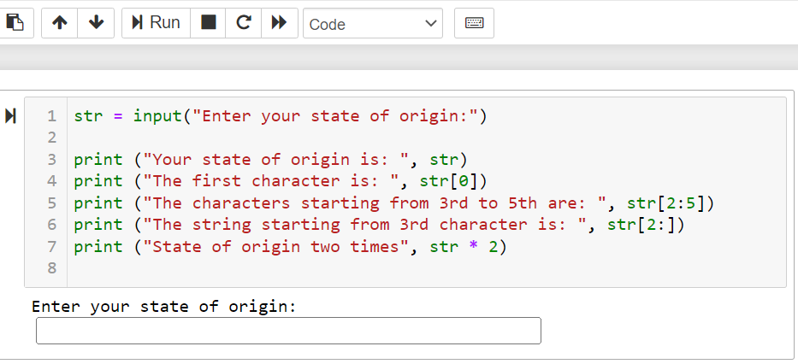
Python String Data Type
Week_3/practice.ipynb/cell_1
Run code: shift + enter

Slide 5
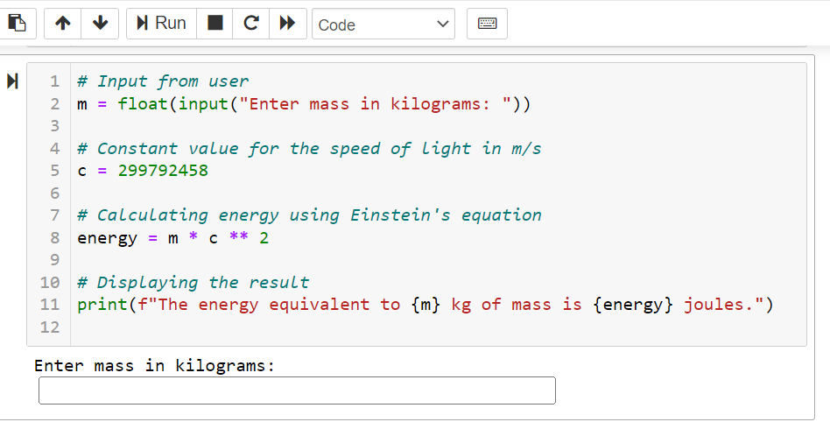
Python Numeric Data Type
Week_3/practice.ipynb/cell_2

Slide 6
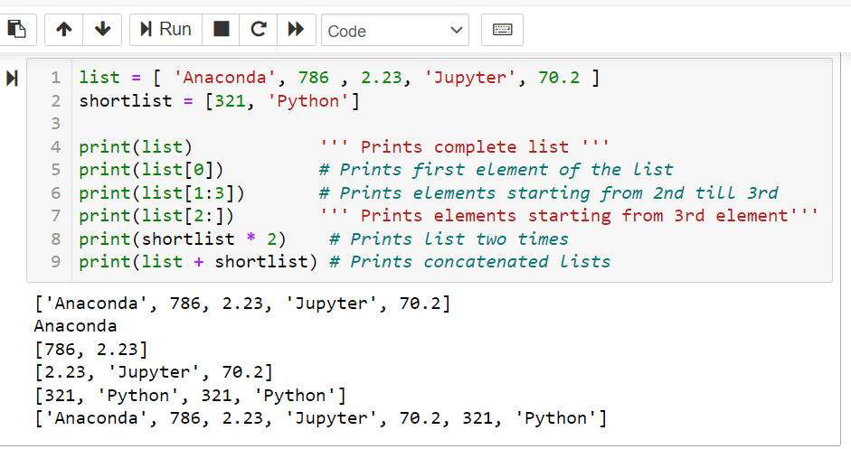
Python List Data Type
Week_3/practice.ipynb/cell_3

Slide 7
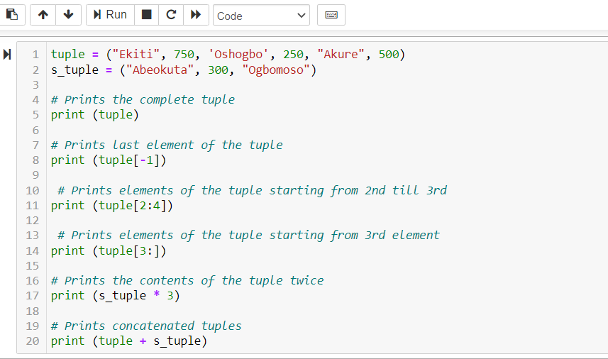
Python Tuple Data Type
Week_3/practice.ipynb/cell_4

Slide 8
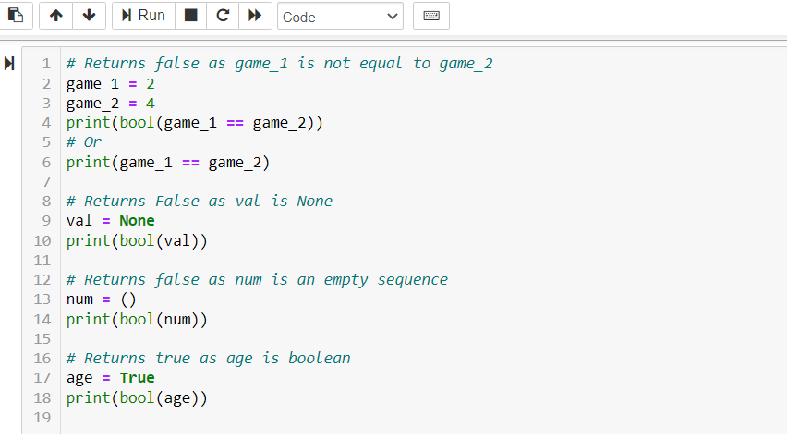
Python Boolean Data Type
Week_3/practice.ipynb/cell_5

Slide 9
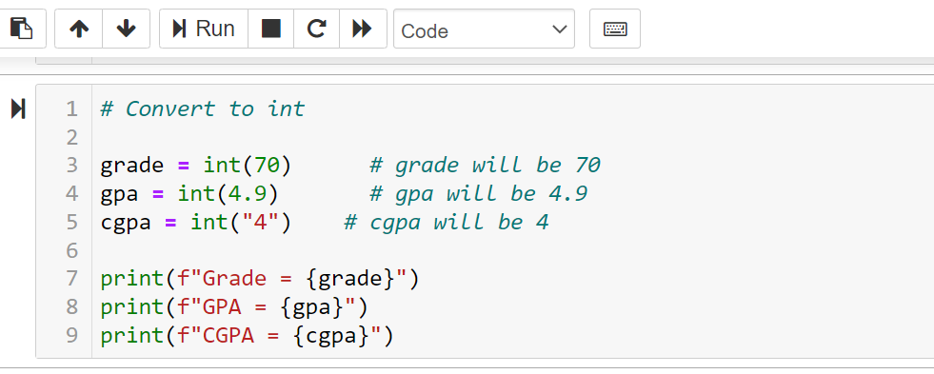
Python Data Type Conversion
Sometimes, you may need to perform conversions between the built-in data types.
To convert data between different Python data types, you simply use the type name as a function.
Week_3/practice.ipynb/cell_6

Slide 10
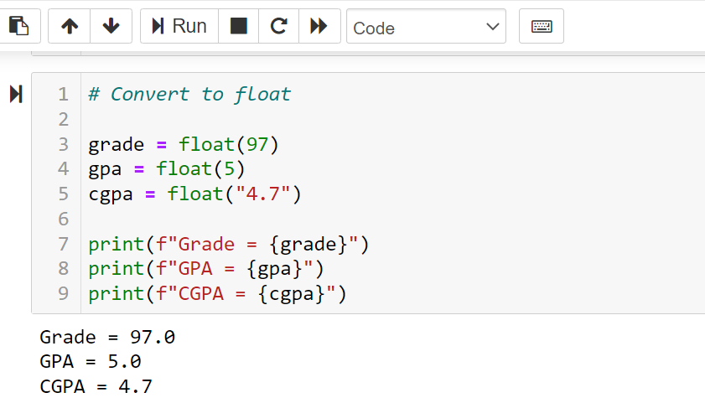
Python Data Type Conversion
Week_3/practice.ipynb/cell_7

Slide 11
Class Project

Slide 12
Project 1
Develop the pseudocode and flowchart for store checkout after purchase
B
Design a flowchart for your typical weekday morning routine.
C
Develop an algorithm that takes as input two names and their corresponding age and then swap the ages.
A

Slide 13
Project 2
A
Develop an algorithm and python code to find the root of a Cubic Equation: Ax³ + Bx² + Cx + D = 0
B
Design an algorithm and python code to find the roots of a Quartic Equation.

